Slide 1
Kruskal algorithm
In Kruskal’s algorithm, the set A is a forest. The safe edge added to A is always a least-weight edge in the graph that connects two distinct components.
Kruskal’s algorithm is a greedy algorithm, because at each step it adds to the forest an edge of least possible weight.
It uses a disjoint-set data structure to maintain several disjoint sets of elements. Each set contains the vertices in a tree of the current forest.
1

Slide 2
Disjoint-set data structure
A disjoint-set data structure maintains a collection S = {S1, S2, . . . , Sk} of disjoint dynamic sets. Each set is identified by a representative, which is some member of the set.
there may be a pre specified rule for choosing the representative, such as choosing the smallest member in the set.
Each element of a set is represented by an object. Letting x denote an object, we wish to support the following operations:

Slide 3
Disjoint-set data structure
MAKE-SET(x) creates a new set whose only member (and thus representative) is x. Since the sets are disjoint, we require that x not already be in some other set.
UNION(x, y) unites the dynamic sets that contain x and y, say Sx and Sy, into a new set that is the union of these two sets. The two sets are assumed to be disjoint prior to the operation. Since we require the sets in the collection to be disjoint, we “destroy” sets Sx and Sy, removing them from the collection S.
FIND-SET(x) returns a pointer to the representative of the (unique) set containing x.

Slide 4
An application of disjoint-set data structures
Determining the connected components of an undirected graph. The procedure CONNECTED-COMPONENTS that follows uses the disjoint-set operations to compute the connected components of a graph.
Once CONNECTED-COMPONENTS has been run as a preprocessing step, the procedure SAMECOMPONENT answers queries about whether two vertices are in the same connected component

Slide 5
Algorithm
CONNECTED-COMPONENTS(G)
1 for each vertex v ∈ V[G]
2 do MAKE-SET(v)
3 for each edge (u, v) ∈ E[G]
4 do if FIND-SET(u) ≠FIND-SET(v)
then UNION(u, v)
SAME-COMPONENT(u, v)
1 if FIND-SET(u) = FIND-SET(v)
2 then return TRUE
3 else return FALSE

Slide 6
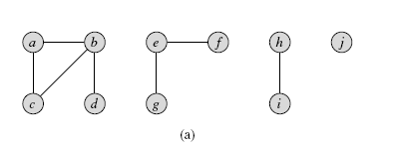
Example

Slide 7
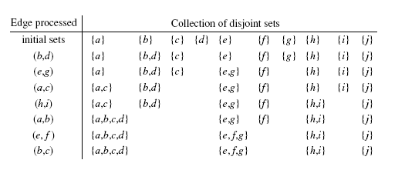
Example

Slide 8
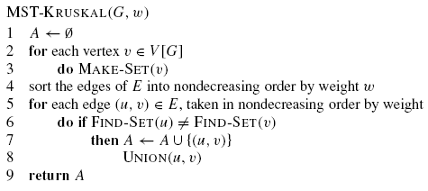
Kruskal’s algorithm

Slide 9
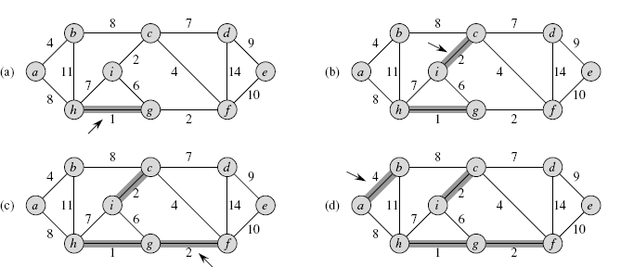
Example

Slide 10
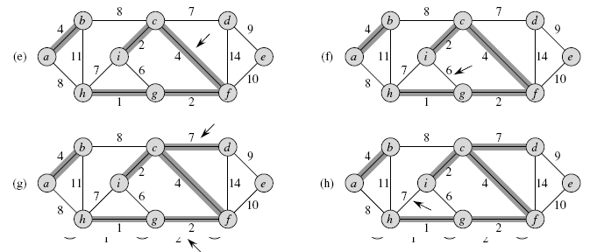
Example

Slide 11
Running time of Kruskal’s algorithm
Initializing the set A in line 1 takes O(1) time,
and the time to sort the edges in line 4 is O(E lg E).
The for loop of lines 5–8 performs O(E) FIND-SET and UNION operations on the disjoint-set forest. Along with the |V| MAKE-SET operations.
So total time is O(E log E + ((V + E) α(V))) time, where α is the very slowly growing function.
Because G is assumed to be connected, we have |E| ≥ |V|−1, and so the disjoint-set operations take O(E α(V)) time.
From theory of disjoint –set operations α(|V|) = O(lg V) = O(lg E), the total running time of Kruskal’s algorithm is O(E lg E).
We know |E| < |V|² so lg |E| = O(lg V), the total running time of Kruskal’s algorithm is O(E lg V).

